Slide 1

ENGINEERING CHEMISTRY
Dr. M. Veerabhadraswamy
Department of Science & Humanities,
Mobile no. 9241503423 e-mail: vbs@pes.edu
1

Slide 2

ENGINEERING CHEMISTRY
Module content:
Hydrogen Storage
Methods of Storage

Slide 3
ENGINEERING CHEMISTRY
Hydrogen Energy
The Hydrogen storage is crucial for effective utilization of Hydrogen for its versatile applications.
Methods used for hydrogen storage:
Liquid form
Gaseous
Solid State
3

Slide 4
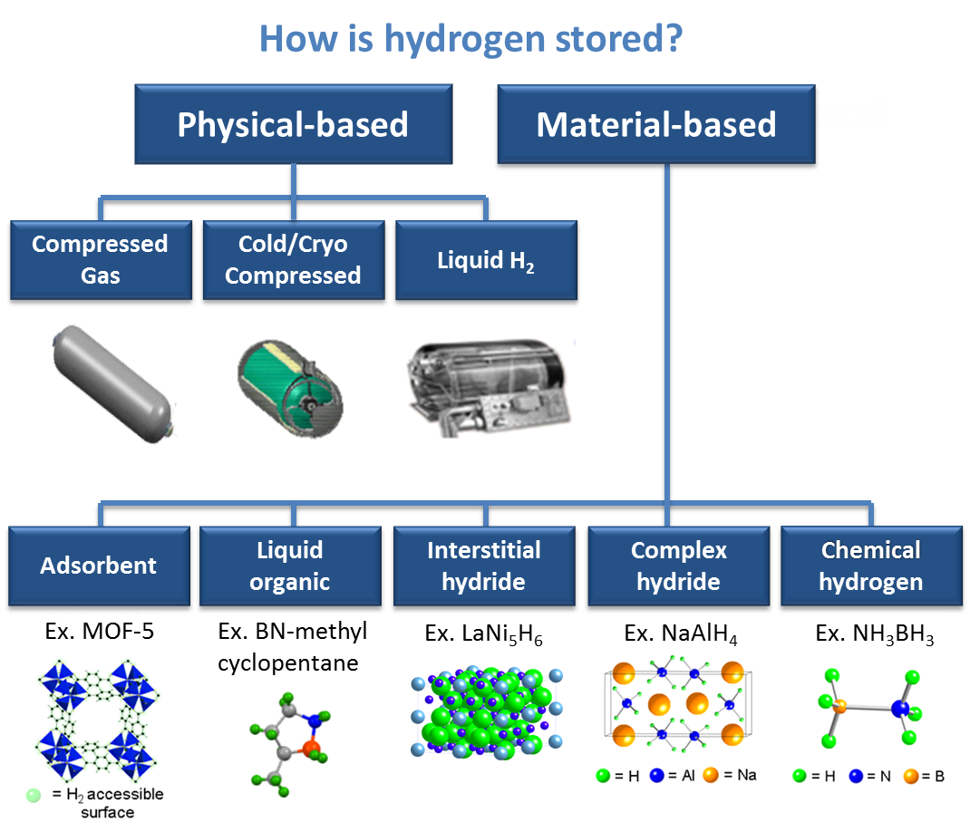
ENGINEERING CHEMISTRY
Hydrogen Storage in Metal-Organic Frameworks: A Review - research journal (gyanvihar.org)

Slide 5
ENGINEERING CHEMISTRY
Hydrogen can be physically stored as either a gas or a liquid
Storage of hydrogen in the form of gas usually requires high-pressure tanks (350–700 bar tank pressure)
Storage of hydrogen as a liquid requires cryogenic temperatures because the boiling point of hydrogen is −252.8°C at an atmospheric pressure
Hydrogen can also be stored on the surfaces of solids (adsorption) or within solids (absorption)
5

Slide 6
ENGINEERING CHEMISTRY
Solid stage hydrogen storage:
Depending on the type of hydrogen being stored in host materials, solid-state hydrogen storage can be classified into two categories:
Chemisorption of hydrogen atoms
Physisorption of intact hydrogen molecules
In chemisorption (absorption into matter), binding of hydrogen atoms occur into the surface
In case of physisorption (adsorption on surface)
The Hydrogen molecule is bound onto the surface of adsorbent

Slide 7
ENGINEERING CHEMISTRY
Some of the most prominent materials for Hydrogen Storage includes
Metal organic framework (MOF) as absorbent
Liquid organic hydrogen carriers (LOHC)
Interstitial hydride
Complex hydride
Chemical Hydrogen storage
7

Slide 8

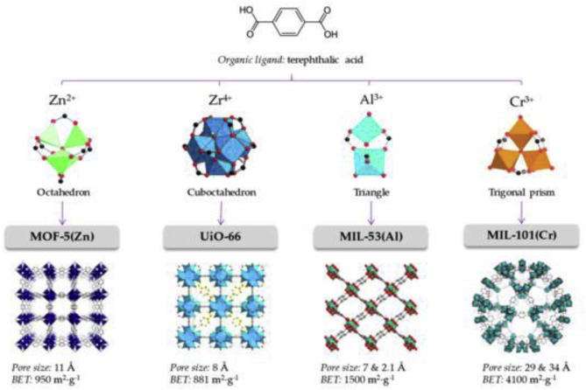
Metal Organic Frame as Absorbent: (MOF)
representing a novel class of porous materials
feature unique pore structure, such as exceptional porosity, tunable pore structures
Enables high density energy storage of clean fuel gas in MOF adsorbents
Zn-MOF (MOF-5) remains an attractive hydrogen storage material due to its balanced gravimetric and volumetric hydrogen uptake

Slide 9
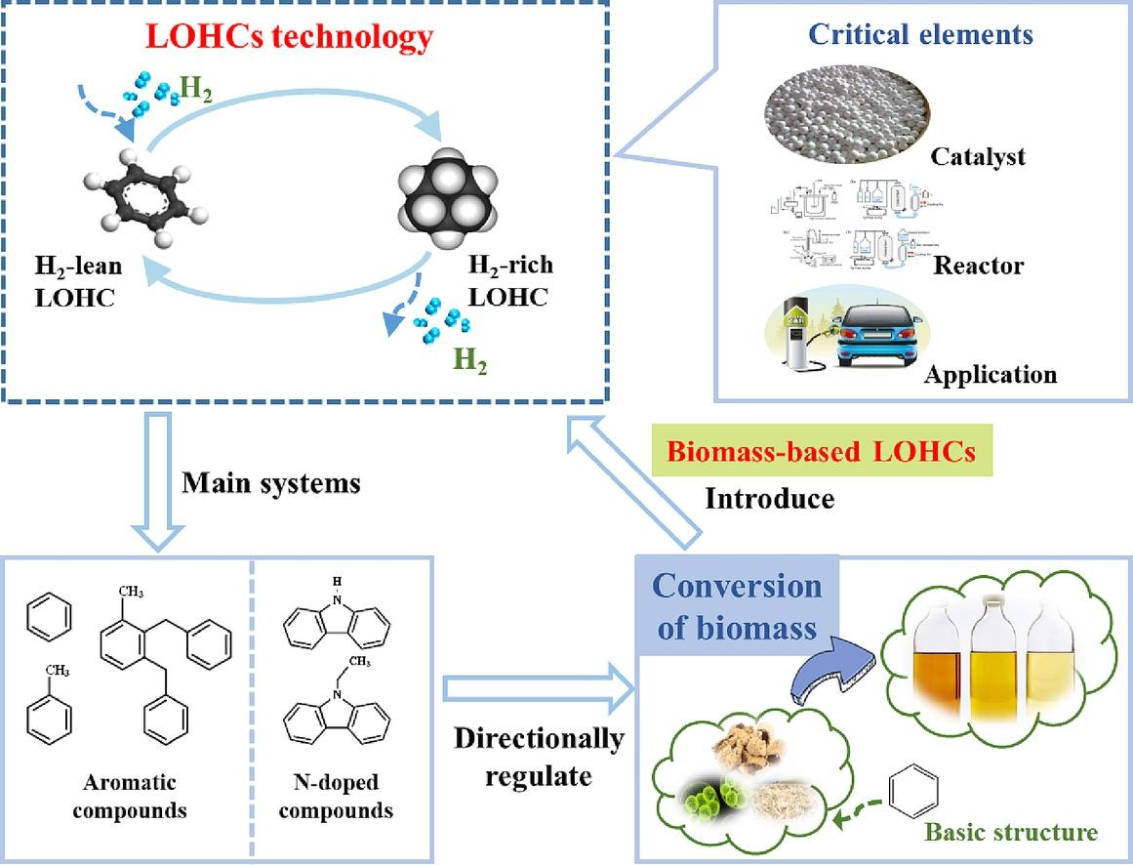
Liquid organic hydrogen carriers (LOHC)
LOHC technology has shown great potential for efficient and stable hydrogen storage and transport
This technology allows for safe and economical large-scale transoceanic transportation and long-cycle hydrogen storage
LOHCs can be used as storage media for hydrogen
Organic compounds that can absorb and release hydrogen through chemical reactions
Methyl cyclopentane
Dibenzyl toluene
1-s2.0-S2588913323000248-ga1_lrg.jpg (1161×886) (els-cdn.com)

Slide 10

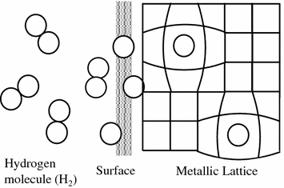
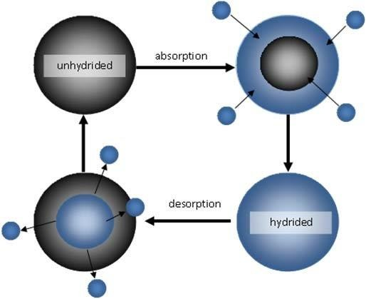
ENGINEERING CHEMISTRY
Interstitial hydride
Contain a larger quantity of hydrogen than the same volume of liquid hydrogen
Have advantage in the amount of hydrogen on a weight basis
Certain interstitial hydrides are very suitable for hydrogen storage and transportation
Example: LiNi₅H₆
Solid Hydrogen Storage Materials: Interstitial Hydrides | SpringerLink
Nanomaterials for Hydrogen Storage Applications: A Review (researchgate.net)

Slide 11
ENGINEERING CHEMISTRY
Complex hydrides
Composed of metal cations (such as Li, Mg, Na, etc.) and hydrogen-containing coordination anions (such as AlH₄–, NH₂–, BH₄– )
On heating, the metallic hydride decomposes to hydrogen and finely divided metal
Example: Sodium aluminate can release up to 7.4% of Hydrogen when heated at 200ºC
3 NaAlH₄ → Na₃AlH₆ + 2Al + 3H₂

Slide 12
ENGINEERING CHEMISTRY
Chemical Hydrogen
Hydrogen is released from a material through a chemical reaction
Hydrogen is restored through a chemical reaction when the material is being recharged
Ammonia Borane (NH₃ -BH₃ ) has exceptional properties for chemical hydrogen gas storage
Hydrolysis of NH₃-BH₃ releases hydrogen stored in it in in presence of catalyst

Slide 13
Advantages
Disadvantages
Liquid form
Gaseous form
Solid form
Liquid H₂ exist at low temperature 20K (-253K)
Stored in cryogenic tanks
Low volume compared gaseous H₂
It involves less infrastructure
More cost effective
Can be compressed into high pressure in gas form
hydrogen can be released whenever required by thermal stimulation or any other technique
Ease of handling
Safety
Reinforced & insulated storage tank required
Cooling and compression process consume energy (net loss about 30%)
Needs extra energy
Space occupied is large
Leak proof tanks needed
Under R & D trials

Slide 14
ENGINEERING CHEMISTRY
Key challenges of the materials and their solutions
All the materials used in storing hydrogen have high specific surface areas, but exhibit weak binding forces with Hydrogen (mostly by Vander Waals forces)
A great deal of research show that metal decorations are effective to increase the bonding energy of hydrogen on sorption-based materials
Hydrogen storage in carbon materials is increased by decorations of these materials with transition metal because of hydrogen spillover phenomenon
Hydrogen spillover is the migration/transfer of hydrogen atom from metal surface into the non-metal support or absorbent
14

Slide 15
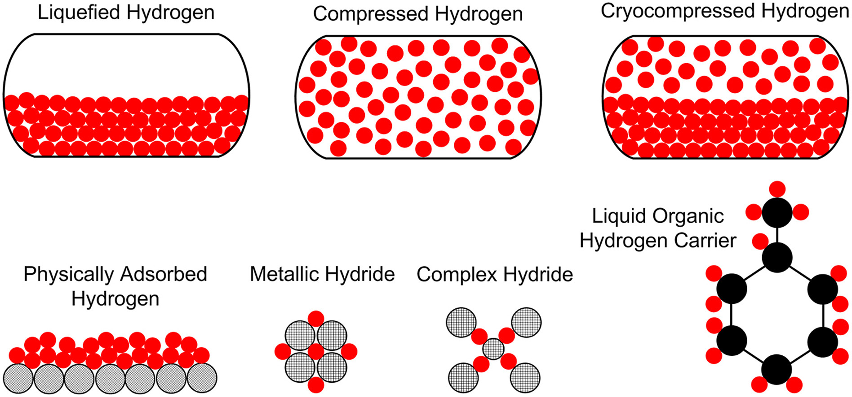
ENGINEERING CHEMISTRY
Conclusion:
The Hydrogen storage technology is rapidly emerging as a fast alternative to fossil fuel but it needs further improvements in terms of infrastructure
Two mechanism are involved in the hydrogen storage, physisorption and chemical absorption
A wide variety of carbonaceous materials, metal organic frameworks hydrates etc are used as hydrogen storage materials
The extensive and increasing research effort in hydrogen storage materials represents an exciting long-term research frontier
Physical and material-based methods of storage of Hydrogen
15

